Slide 1
WELCOME to Gujarat

Slide 2
From sitting around bonfires and listening to stories of mysterious happenings, to making up our own versions of haunted places, we have all grown up discussing the existence/non-existence of ghosts and spirits. They say that we find what we look for. Since millenia, our unwavering belief in the supernatural has led us to see signs of evil where it might/ might not exist. We will probably never be able to answer the age old question of whether or not these things do happen, but what we can do is entertain ourselves with the mere possibilities and their repercussions.

Slide 3
Top 5 Haunted Places in Gujarat
1.Dumas Beach, Surat
2.Avadh Palace, Rajkot
3.GTU campus, Ahmedabad
4.Uparkot Fort, Junagadh
5.Chir Batti, Kutchh

Slide 5
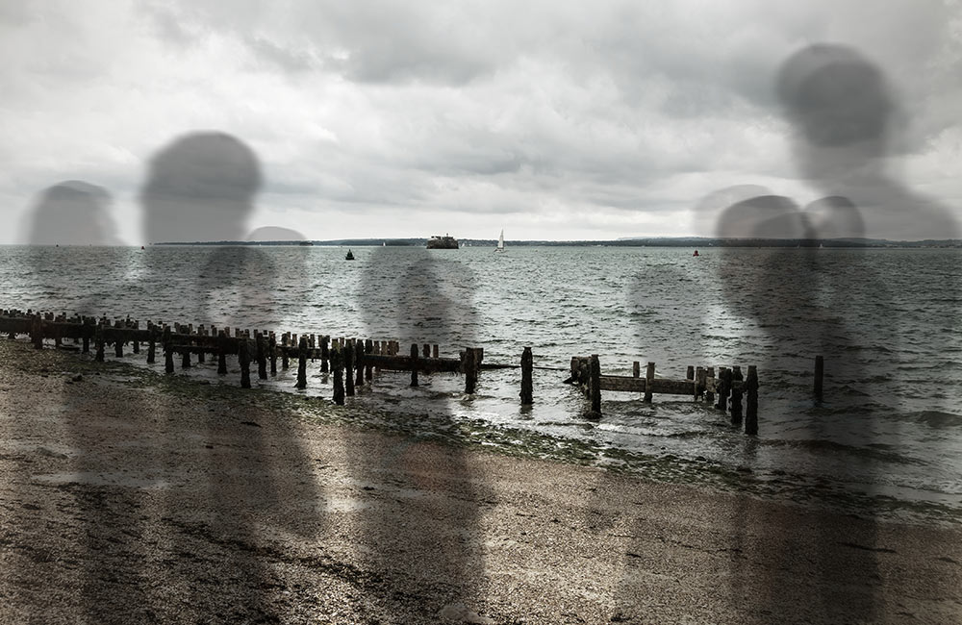
1. Dumas Beach
Known for its serenity and beautiful black sand, Dumas beach is known for being one of the most haunted beaches in the country. Located around 20 kms from Surat, Dumas beach lies along the Arabian Sea and is considered to be one of the most haunted places in Gujarat. The stories of haunted sightings along the beach sound like something out of a movie script.

Slide 6
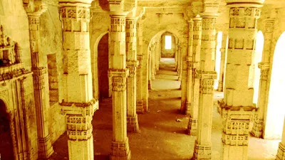
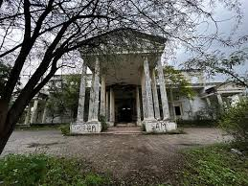
2. Avadh Palace
According to locals, a girl was raped by a group of people, after that she was murdered and burnt in the same building and since then it is said that her spirit haunts the building. No one dares to visit this building at night.

Slide 7
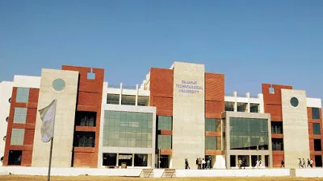
3. Gujarat Technological University
According to Ahmedabad Mirror, “Vijay Vaghela, in-charge at Anusuya Outsourcing that posts peons and lift-men at GTU, said, “Our employee Jignesh Shah was using the GTU lift around 5 pm on Saturday when he felt the presence of a woman next to him.

Slide 8

4. Uparkot Fort
Many people have experienced paranormal activities taking place in this fort. This fort has Jama Masjid which was previously a temple and a mosque area is place which has reported the most number of haunting cases.

Slide 9
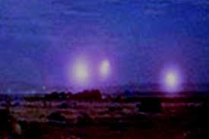
5. Chir Batti, Rann of Kutchh
Chir means ‘ghost’ and Batti means ‘light’, so Chir Batti Means Ghost light. An unexplained red, yellow or blue color light ball of fire can be spotted on dark nights. This light moves fast and it appears 2 to 10 feet above the ground.

Slide 10
As we traverse the realms where the mundane and the supernatural intertwine, let these tales serve as cautionary reminders. In the twilight between fact and folklore, Gujarat's haunted places invite us to ponder the mysteries that linger beyond the visible, urging us to approach with respect and an acknowledgment of the enigmatic forces that shape these chilling narratives.

Slide 11
Thank You
For Visiting

